Slide 1
Architecture Design
Instructor: Mehroze Khan

Slide 2
The Design Process
Design is the creative process of figuring out how to implement all the customer’s requirements; the resulting plan is also called the design.
Early design decisions address the system’s architecture, explaining how to:
Decompose the system into units
How the units relate to one another
Describe any externally visible properties of the units
Later design decisions address how to implement the individual units.

Slide 3
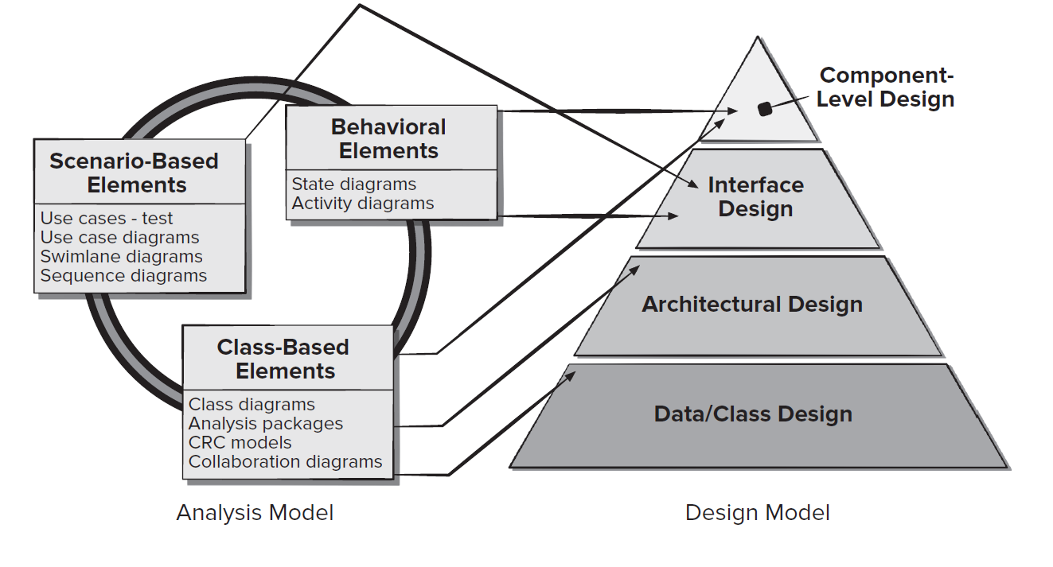
Translating Requirements to Design

Slide 4
Requirements and Design
To see how architecture relates to both design and requirements, consider the example to build a new house.
The requirements include:
Rooms for parents and three children
A place for the children to play
A kitchen and a large dining room that will hold an extendable table
Storage for bicycles, lawn mower, ladder, barbecue.
Heating and air conditioning

Slide 5
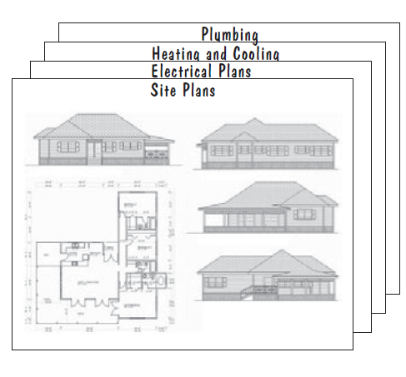
Architectural Plans

Slide 6
Multiple Designs
Maximize playing area
Minimize playing area
Large bedrooms
Two story house
Single story house
Which is the best design?
Will a proposed solution result in modified requirements?

Slide 7
The Design Process Design is a Creative Process
Design is an intellectually challenging task
Numerous possibilities the system must accommodate
Non-functional design goals (e.g., ease of use, ease to maintain)
External factors (e.g., standard data formats, government regulations)
We can improve our design by studying examples of good design
Most design work is routine design, solve problem by reusing and adapting solutions from similar problems

Slide 8
The Design Process Design is a Creative Process
Using already available designs and solutions provides:
Efficiency (in quickly settling on a plan)
Predictability (in knowing that the resulting product should be similar in quality to existing one)

Slide 9
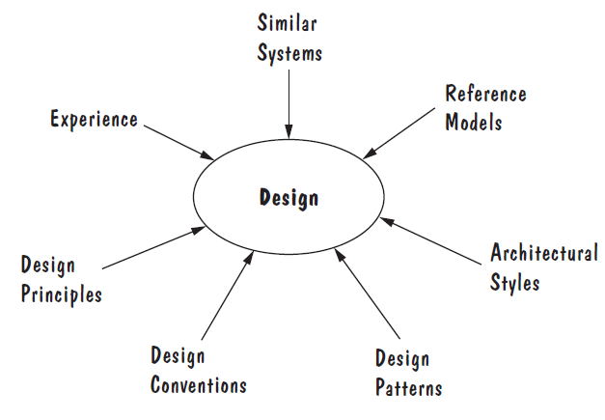
The Design Process Design is a Creative Process
Sources of Design Advise

Slide 10
The Design Process Design is a Creative Process
Ways to Leverage Existing Solutions:
Cloning: Borrow a whole design/code, make minor adjustments to fit the problem.
Reference Model: A standard generic architecture that suggests how to decompose a system into its major components and how those components interact with each other.
Software architectures have generic solutions too, called architectural styles.
Focusing on one architectural style can create problems
Good software architectural design is about selecting, adapting, and integrating several architectural styles in ways that best produce the desired result.
Notes:
Like reference models, architectural styles give advice about how to decompose a problem into software units and how those units should interact with each other.
Unlike reference models, architectural styles are not optimized for specific application domains. Rather, they give generic advice about how to approach generic design problems

Slide 11
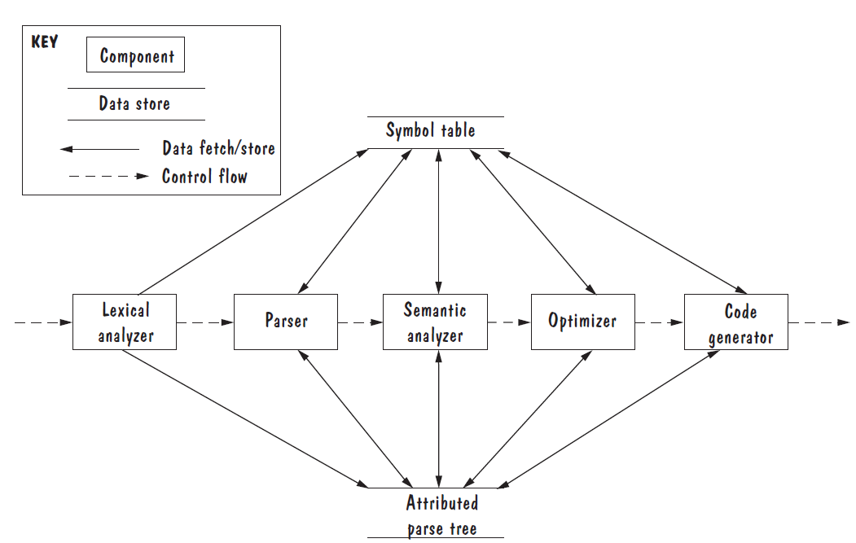
Reference Model of a Compiler

Slide 12
The Design Process Design is a Creative Process
Ways to Leverage Existing Solutions(Continued):
Design patterns are generic solutions for making lower-level design decisions about individual software modules or small collections of modules.
A design convention or idiom is a collection of design decisions and advice that, taken together, promotes certain design qualities.
The guidance we can use in innovative design is a set of basic design principles that are descriptive characteristics of good design, rather than prescriptive advice about how to design.
Notes:
Design Convention example, abstract data types (ADTs) are a design convention that encapsulates data representation and supports reusability
Sometimes, existing solutions cannot solve a problem satisfactorily; we need a novel solution that requires innovative design. In contrast to routine design, the innovative design process is characterized by irregular bursts of progress that occur as we have flashes of insight.

Slide 13
Design Process Model Design is an Iterative Process
During the first part of the design phase, we iterate among three activities:
Drawing architectural plans
Analyzing how well the proposed architecture promotes desired properties
Using the analysis results to improve and optimize the architectural plans
At the architectural stage, we focus on system-level decisions
Communication
Coordination
Synchronization
Sharing
As the architecture starts to stabilize
Document models.
Each of the models is an architectural view, and the views are interconnected
A change to one view may have an impact on other views.

Slide 14
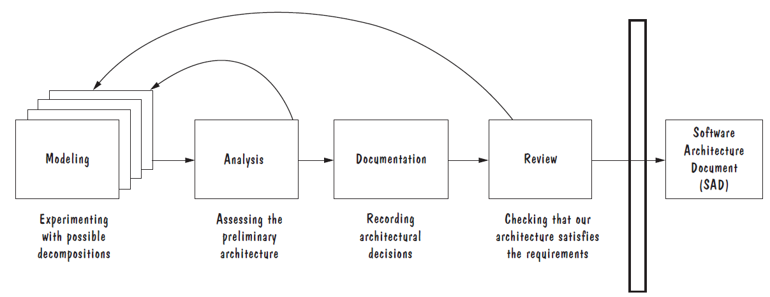
Design Process Model Design is an Iterative Process
Once the architecture is documented
Conduct a formal design review, in which the project team checks that the architecture meets all the system’s requirements and is of high quality.
If problems are identified during the design review, we may have to revise our design yet again to address these concerns.
The outcome of the software architecture process is the SAD, used to communicate system-level design decisions to the rest of the development team.

Slide 15
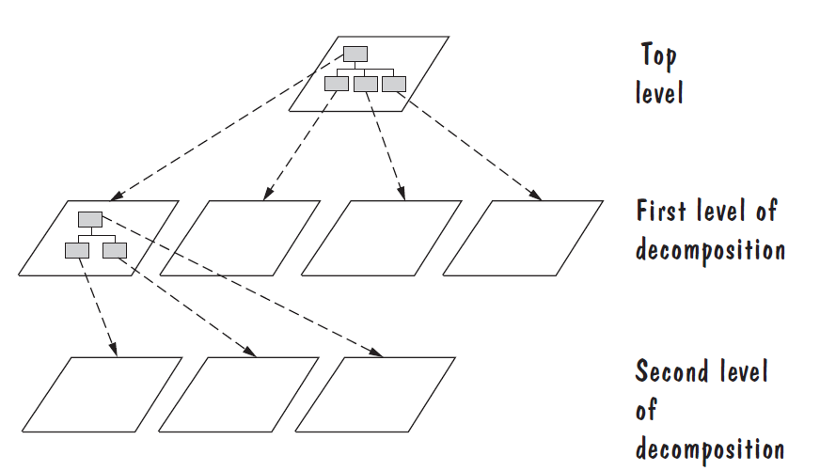
Decomposition and Views
Design by decomposition starts with a high-level description of the system’s key elements.
Iteratively refine the design by dividing system’s elements into its constituent pieces and describing their interfaces.

Slide 16
Design Methods
Some popular design methods:
Functional decomposition
Feature-oriented decomposition
Data-oriented decomposition
Process-oriented decomposition
Event-oriented decomposition
Object-oriented design

Slide 17
Design Methods
Functional decomposition:
Partitions functions or requirements into modules.
Lower-level designs divide these functions into subfunctions, which are then assigned to smaller modules.
The design also describes which modules (subfunctions) call each other.

Slide 18
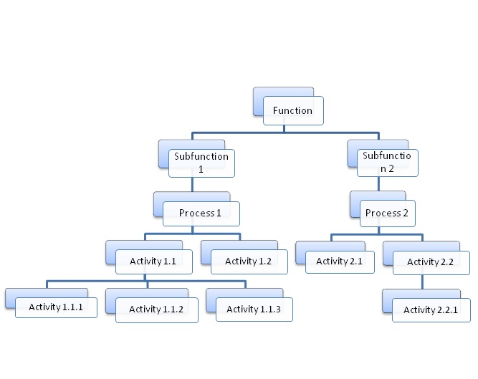
Functional Decomposition

Slide 19
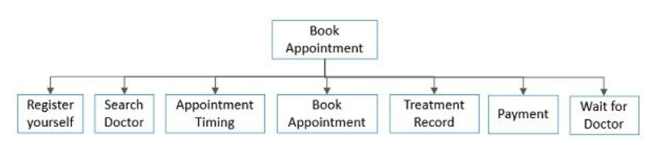
Functional Decomposition Example
Suppose that you need to design software that can be used by the patients to make an appointment with the doctor.

Slide 20
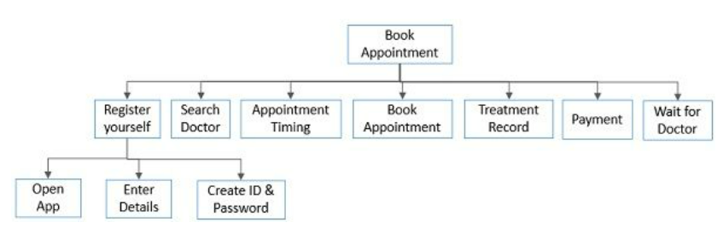
Functional Decomposition Example

Slide 21
Functional Decomposition Example
Student Registration System
Data Entry Validation
Transaction Verification
Report Generation
Data Updation
Student Data Validation
Course Data Validation
Transaction Checks
Addition Modules
Deletion Module

Slide 22
Design Methods
Feature-oriented design:
Assigns features to modules.
High-level design describes the system in terms of a service and a collection of features.
Lower-level designs describe how each feature augments the service and identifies interactions among features.
Data-oriented decomposition:
Focuses on how data will be partitioned into modules.
High-level design describes conceptual data structures
Lower-level designs provide detail as to how data are distributed among modules and how the distributed data realize the conceptual models.

Slide 23
Design Methods
Process-oriented decomposition:
Partitions the system into concurrent processes.
High-level design
Identifies the system’s main tasks
Assigns tasks to runtime processes
Explains how the tasks coordinate with each other.
Lower-level designs describe the processes in more detail.
Event-oriented decomposition:
Focuses on the events that the system must handle and assigns responsibility for events to different modules.
High-level design catalogues the system’s expected input events.
Lower-level designs decompose the system into states and describe how events trigger state transformations.

Slide 24
Design Methods
Object-oriented design:
Assigns objects to modules.
High-level design identifies the system’s object types and explains how objects are related to one another.
Lower-level designs detail the objects’ attributes and operations.

Slide 25
Decomposition and Views
A design is modular when each activity of the system is performed by exactly one software unit, and when the inputs and outputs of each software unit are well-defined
A software unit is well-defined if its interface accurately and precisely specifies the unit’s externally visible behaviour
Modularity is the most common manifestation of separation of concerns. Software is divided into separately named and addressable components, sometimes called modules, that are integrated to satisfy problem requirements.

Slide 26
Architectural Styles
Software architectural styles are established, large-scale patterns of system structure.
They have defining rules, elements, and techniques that result in designs with recognizable structures and well understood properties.
Not complete detailed solutions. Rather, they are loose templates that offer distinct solutions for coordinating a system’s components.
Focus on the different ways that components might communicate, synchronize, or share data with one another.

Slide 27
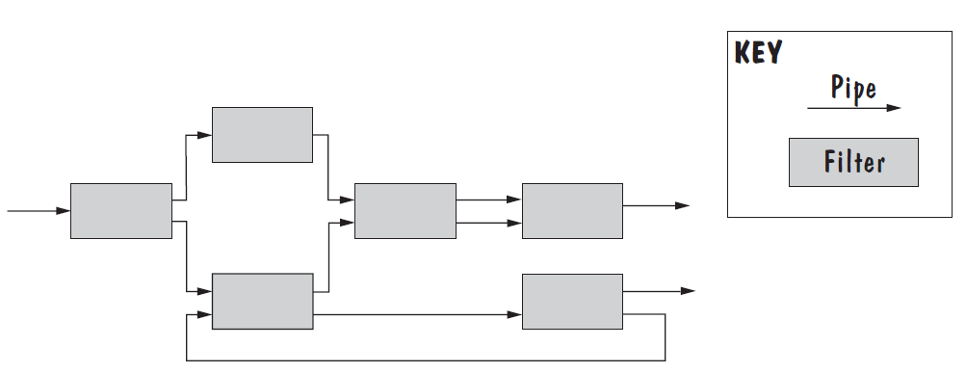
Pipe and Filter
System functionality is achieved by passing input data through a sequence of data-transforming components, called filters, to produce output data.
Pipes are connectors that simply transmit data from one filter to the next without modifying the data.

Slide 28
Pipe and Filter
Several important properties
The designer can understand the entire system's effect on input and output as the composition of the filters
The filters can be reused easily on other systems
System evolution is simple
Allow concurrent execution of filters
Drawbacks
To support a fixed data format during data transmission, each filter must parse input data before performing its computation and then convert its results back to the fixed data format for output. This repeated parsing and unparsing of data can hamper system performance.
Not good for handling interactive application

Slide 29
Client Server
Two types of components:
Server components offer services
Clients access them using a request/reply protocol.
The components execute concurrently and are usually distributed across several computers.
There may be one centralized server, several replicated servers distributed over several machines, or several distinct servers each offering a different set of services.
The relationship between clients and servers is asymmetric: Clients know the identities of the servers from which they request information, but servers know nothing about which, or even how many, clients they serve.

Slide 30
Client Server
Clients initiate communications by issuing a request, as a message or a remote-procedure call
Servers respond by fulfilling the request and replying with a result.
Normally, servers are passive components that simply react to clients’ requests, but in some cases, a server may initiate actions on behalf of its clients.
For example, a client may send the server an executable function, called a callback, which the server subsequently calls under specific circumstances.

Slide 31
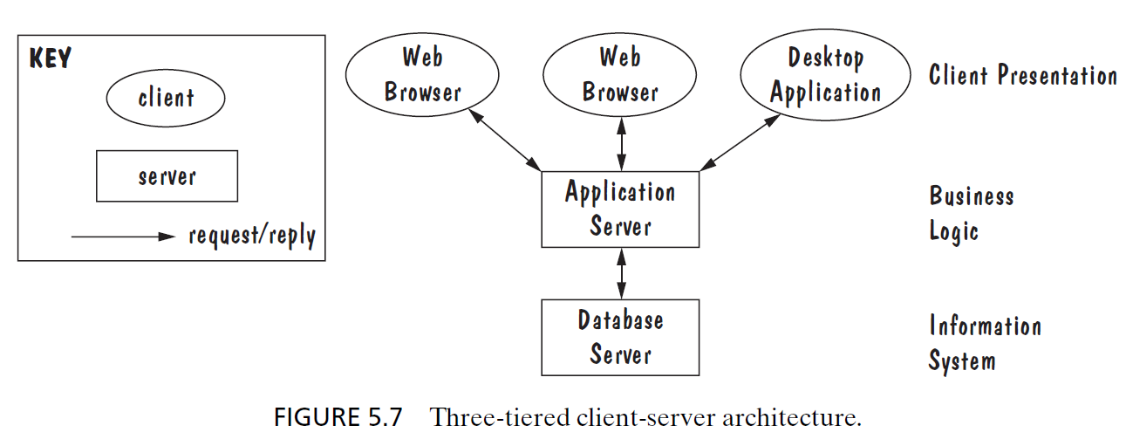
Client Server

Slide 32
Peer-to-Peer
A peer-to-peer (P2P) architecture is one in which each component executes as its own process and acts as both a client of and a server to other peer components.
Each component has an interface that specifies not only the services it provides, but also the services that it requests from other peer components.
Peers communicate by requesting services from each other.
Any component can initiate a request to any other peer component.
What differs among components are the data each component stores locally.
System’s data are distributed among the components; whenever a component needs information not stored locally, it retrieves it from a peer component.

Slide 33
Peer-to-Peer
The best-known P2P architectures are file-sharing networks, such as Napster and Freenet, in which the components provide similar services to each other.
P2P Networks Advantages:
They scale up well.
Each added component increases the system’s capabilities, in the form of new or replicated data and as additional server capacity.
Highly tolerant of network failures, because data are replicated and distributed over multiple peers.
P2P Networks Disadvantage:
Each added component increases demands on the system in the form of additional requests.

Slide 34
Peer-to-Peer
When NOT to use:
When file contents change frequently (e.g. prices)
When sharing speed has importance (e.g. large files are needed quickly)
File quality is critical
When trust between peers is required (e.g. the content is protected)

